Slide 1
WEB DEVELOPMENT
Internship Task Presentation(IPL-Team)
HK Maruthi
ShadowFox
February Batch

Slide 2
CONTENTS
ACKNOWLEDGEMENT
INTERMEDIATE LEVEL
CONCLUSION

Slide 3
ACKNOWLEDGEMENT
I would like to express my gratitude to ShadowFox for giving me this opportunity.
Special thanks to my coordinator, Mr. Aakash, for his guidance throughout my internship.
This internship provided valuable hands-on experience in web development.

Slide 4
INTERMEDIATE LEVEL
Task: Development of a Web Application for Sunrisers Hyderabad
Designed and implemented a webpage using HTML & CSS.
Developed sections for Players, Matches, News, Gallery, and Contact.
Ensured responsiveness and optimized media handling.

Slide 5
WEBPAGE STRUCTURE
Header: Includes logo and navigation bar.
Hero Section: Displays the main banner.
Players Section: Showcases team members with images.
News & Matches: Provides match updates and news articles.
Gallery: Displays images related to the team.
Contact: Allows users to connect with the team.

Slide 6
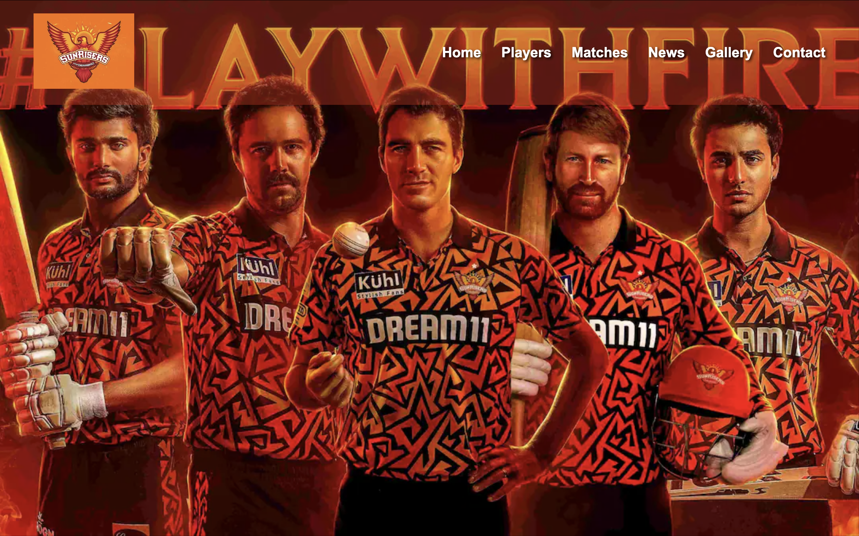
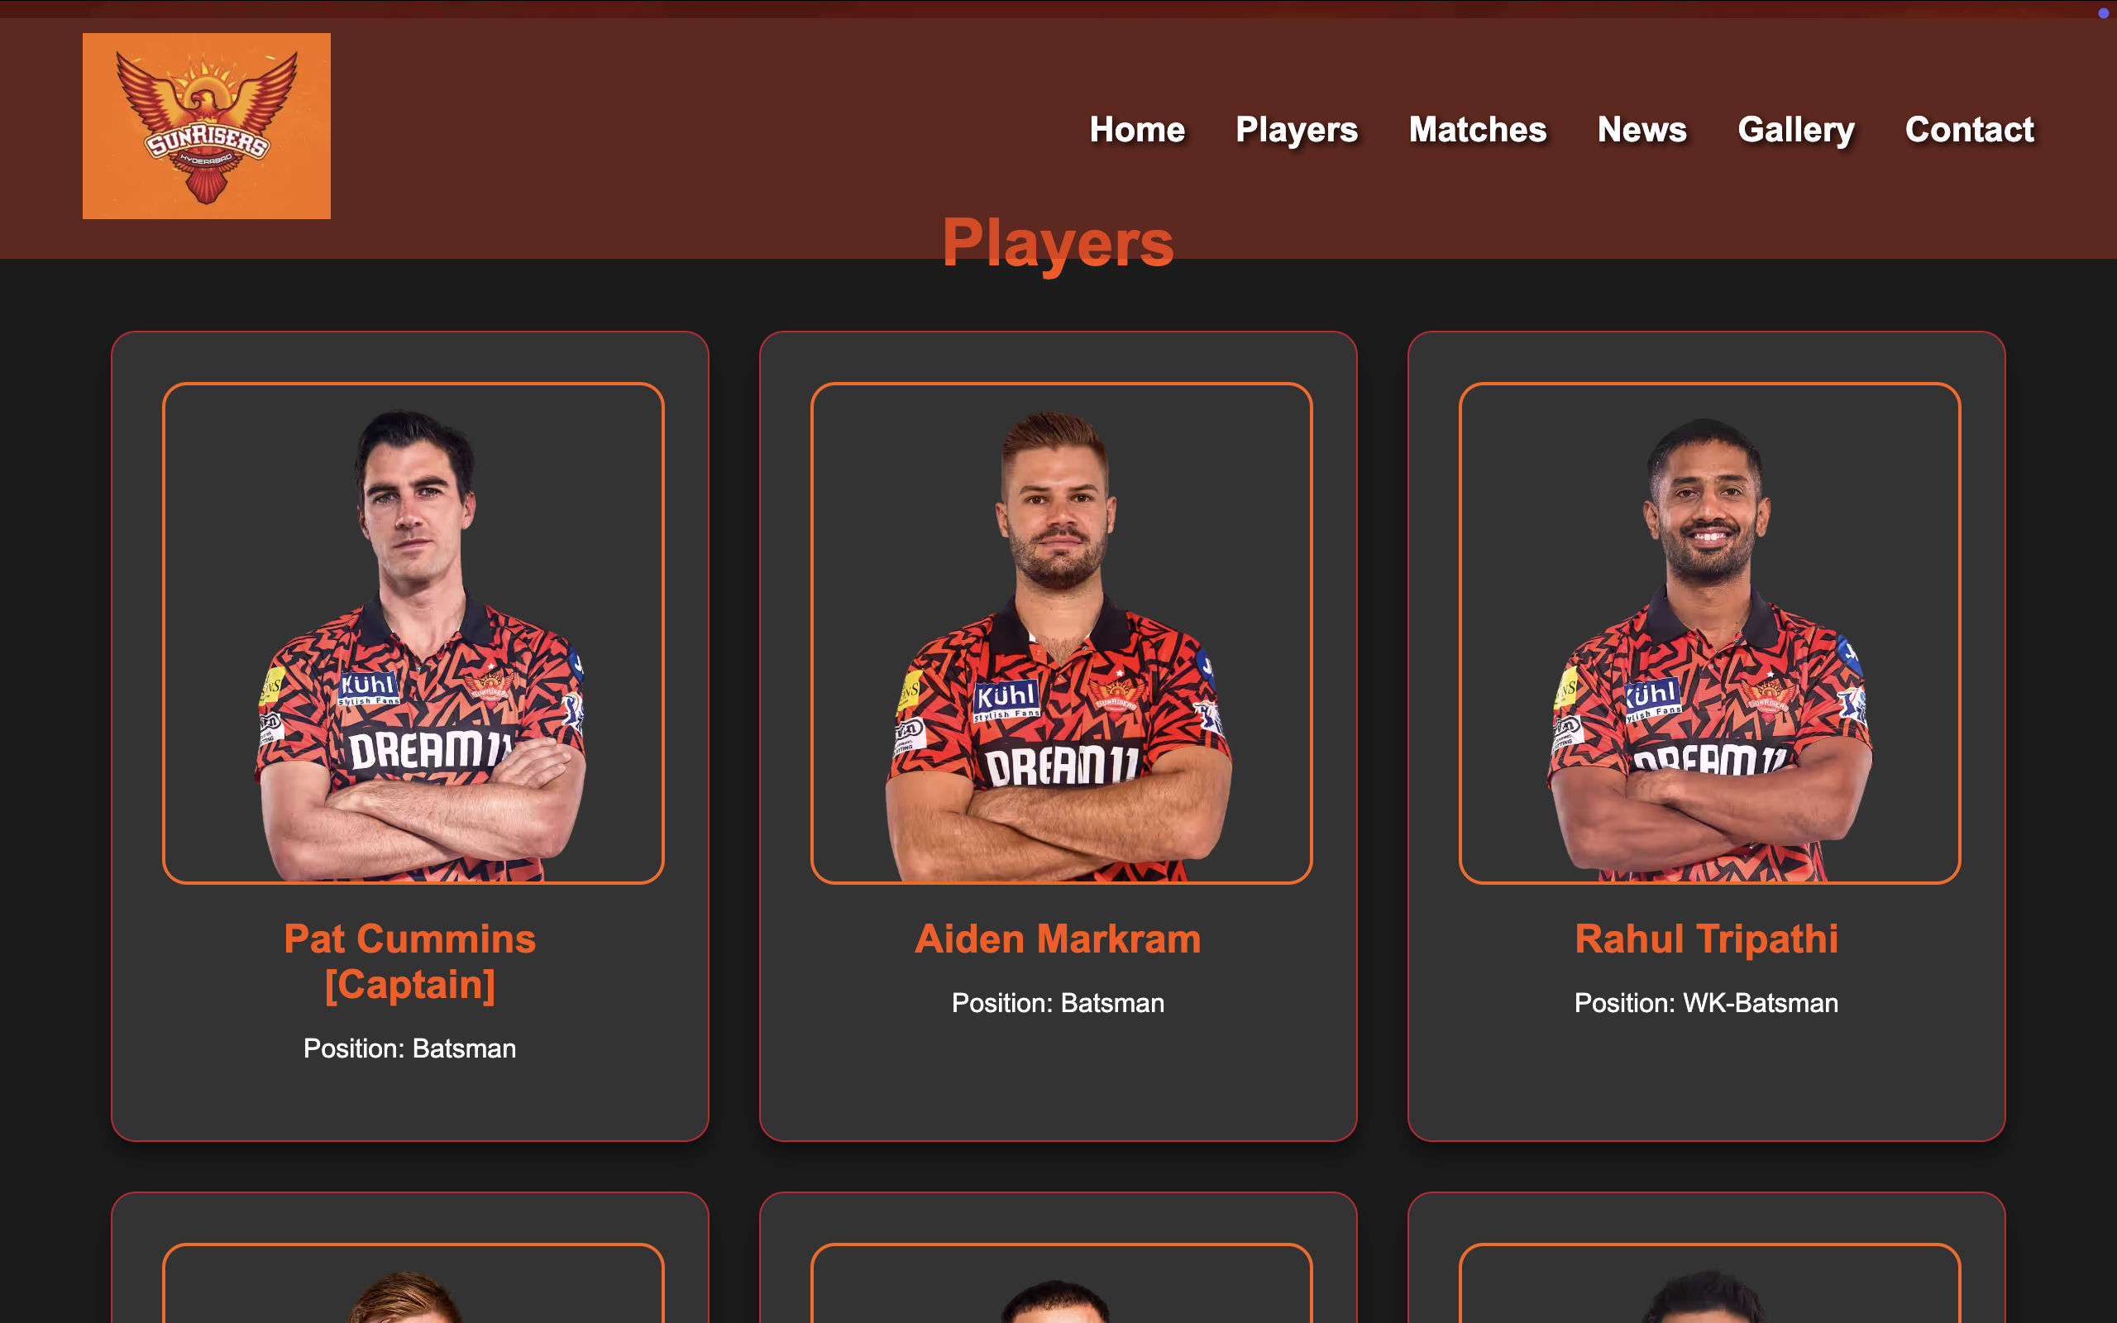
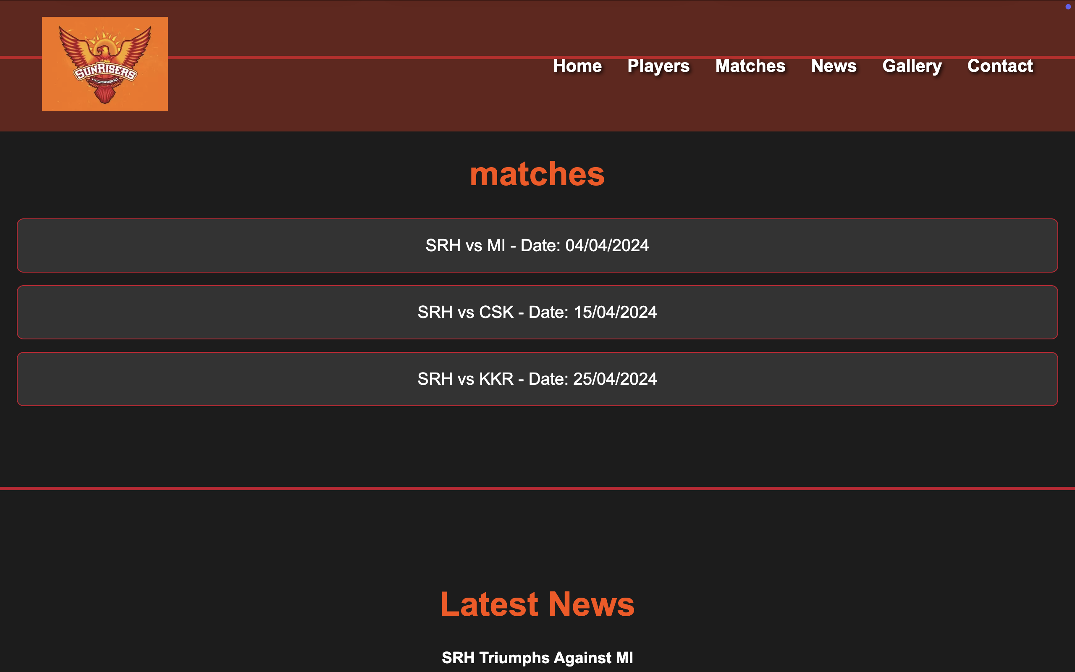
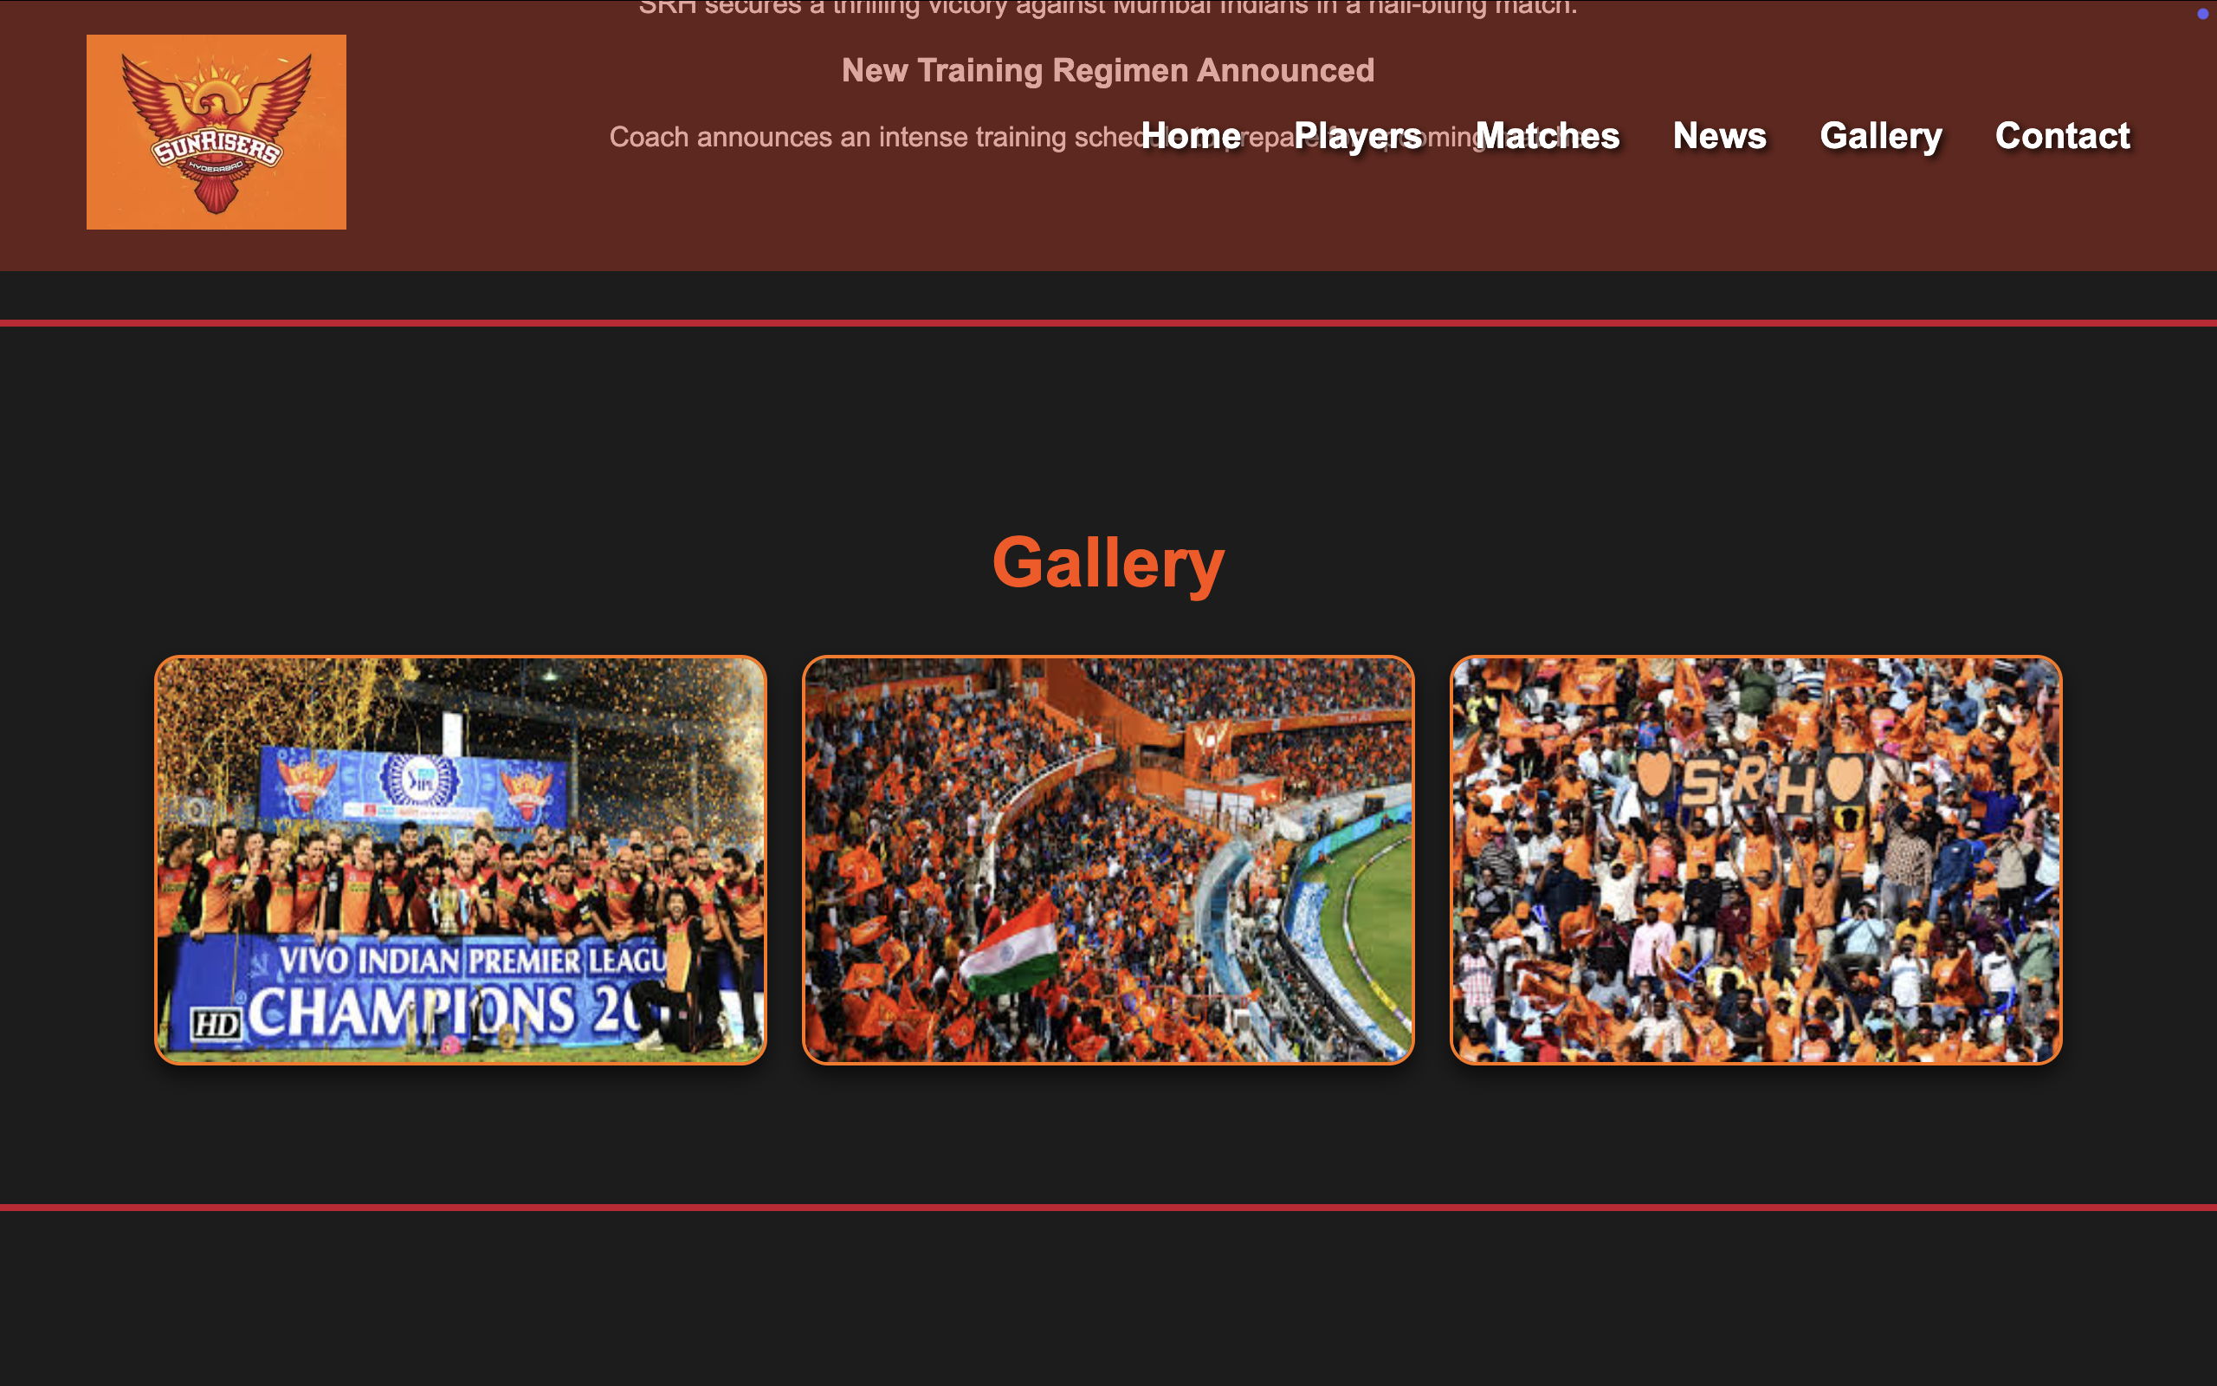
Output images

Slide 7
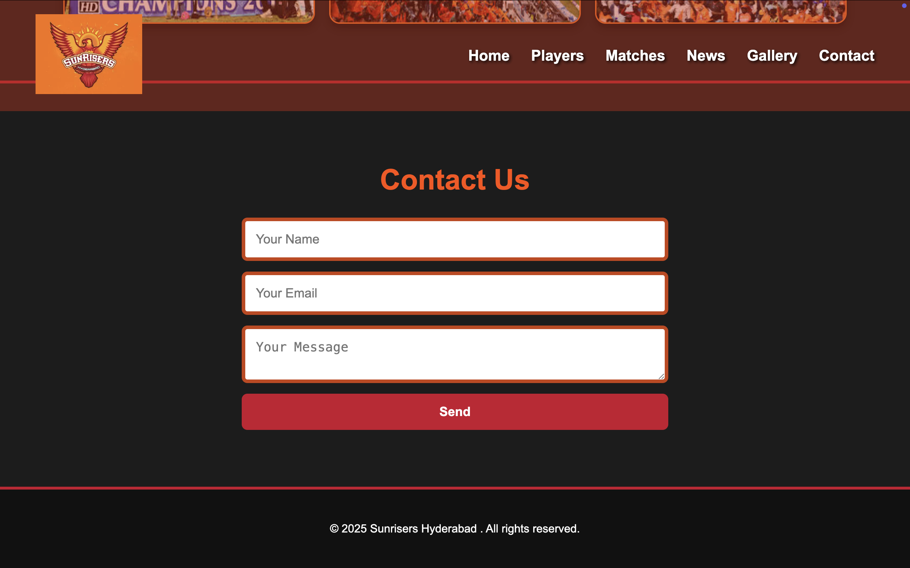

Slide 8
CHALLENGES & SOLUTIONS
Cross-Browser Compatibility: Ensured uniform appearance across different browsers.
Performance Optimization: Optimized images and implemented lazy loading.
UI/UX Improvements: Enhanced readability with structured layouts and styling.

Slide 9
CONCLUSION
This internship provided an enriching experience where I applied theoretical knowledge to real-world web development. The project enhanced my UI/UX skills and problem-solving capabilities.

Slide 10
THANK YOU!

